Slide 1
The Challenge
Use a steady state flow model, build in Excel, to show the following:
Based on the flux with depth, show that the model is steady state. Repeat this for a homogeneous and for a heterogeneous column.
Show that the steady state flux agrees with the direct calculation based on the harmonic mean average K. Write the equation defining the direct calculation of the flux.
Show the steady state head profile for a column with approximately equal-thickness layers that have different K values. Use the head profile to explain WHY the equivalent hydraulic conductivity, Keq, is closer to the lower of the two K values.

Slide 2
The Challenge
Use a steady state flow model, build in Excel, to show the following:
Based on the flux with depth, show that the model is steady state. Repeat this for a homogeneous and for a heterogeneous column.
Show that the steady state flux agrees with the direct calculation based on the harmonic mean average K. Write the equation defining the direct calculation of the flux.
Show the steady state head profile for a column with approximately equal-thickness layers that have different K values. Use the head profile to explain WHY the equivalent hydraulic conductivity, Keq, is closer to the lower of the two K values.
Other suggested points for consideration were:
What are boundary conditions? Answer this both conceptually and mathematically.
What are model parameters? How do they (and don't they) represent the actual subsurface?
What are steady state conditions and how can they be identified from the Excel model results?
Can you imagine how the model inputs could be stored in separate files rather than other spreadsheet cells? Describe the flow of information from a file that describes the other files that contain model-specific information about the system.
What is an iterative solution? Can you explain it to a hydrologist who is not a modeler? Can you describe (or imagine) how Excel finds the solution?
What is a direct solution? What are its (dis)advantages compared to an iterative (numerical) solution?

Slide 3
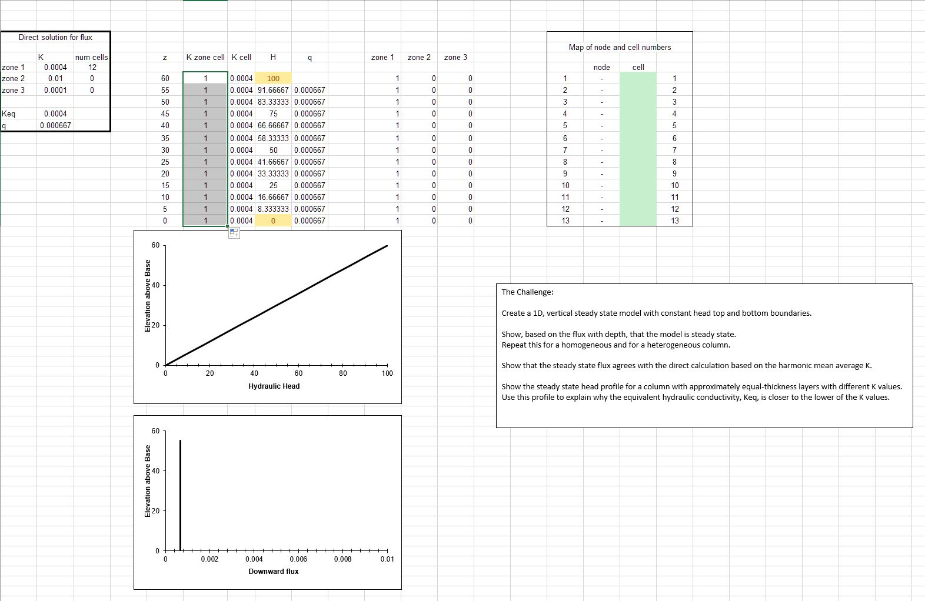
The Key Figures
For a homogeneous medium, the model shows:
We modeled a homogeneous column by defining the same soil type in every cell.

Slide 4
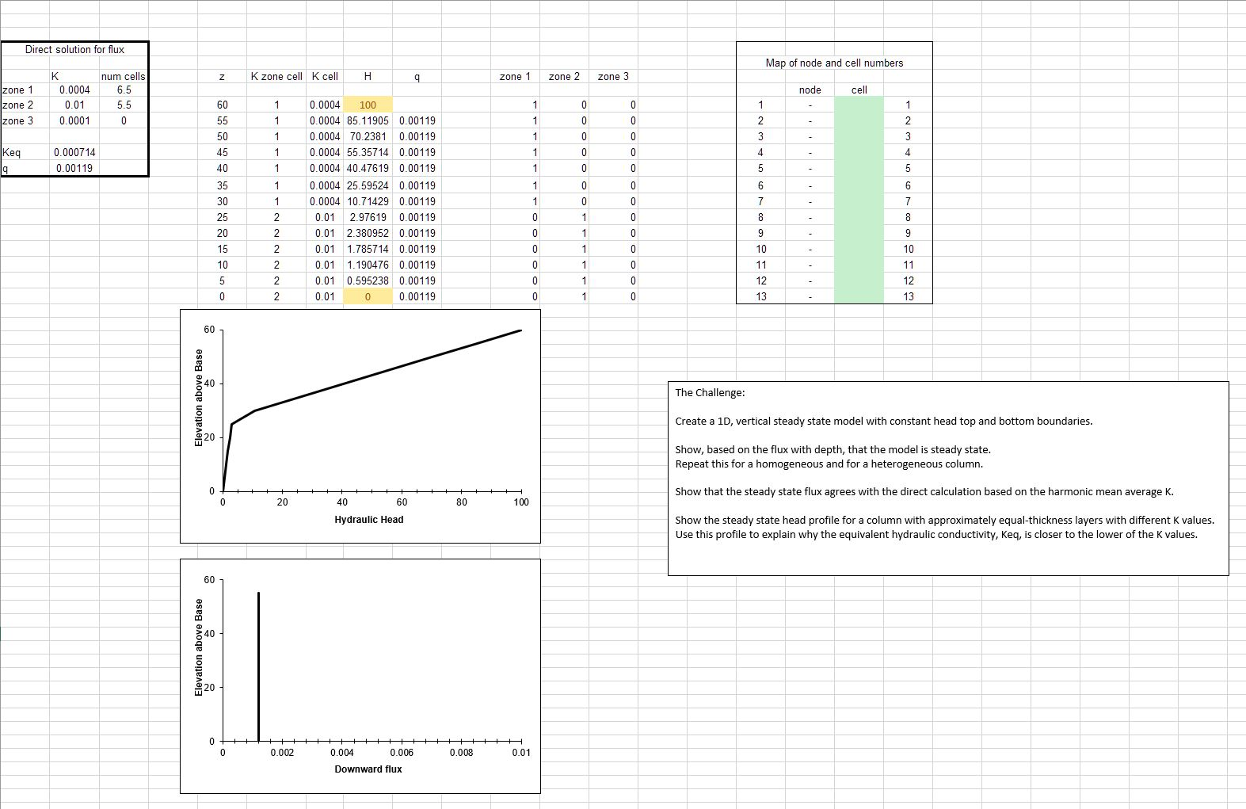
The Key Figures
For a heterogeneous medium, the model shows:
We modeled a heterogeneous column by defining a higher conductivity soil type in the bottom six cells and a lower K soil type in the upper seven.

Slide 5
Based on the flux with depth, show that the model is steady state. Repeat this for a homogeneous and for a heterogeneous column.
Steady state means that the head is constant at every location through time. This model doesn’t show results through time, so this form of the definition is not useful for proving that the system has reached steady state.

Slide 6
Based on the flux with depth, show that the model is steady state. Repeat this for a homogeneous and for a heterogeneous column.
Steady state means that the head is constant at every location through time. This model doesn’t show results through time, so this form of the definition is not useful for proving that the system has reached steady state.
Steady state also means that there is no change in storage anywhere. This can be shown if the flow into and out of any cell is constant. For the constant cross section column, this is shown by the constant flux with depth.

Slide 7
Based on the flux with depth, show that the model is steady state. Repeat this for a homogeneous and for a heterogeneous column.
Note that – the figure shown here is not at steady state. The calculated flux varies slightly from cell to cell.
We would like group 1 to address this in the breakout. How can you get Excel to reach steady state? Discuss how you think Excel finds the steady state solution.

Slide 8
Show that the steady state flux agrees with the direct calculation based on the harmonic mean average K. Write the equation defining the direct calculation of the flux.
The equivalent K for flow in series is the harmonic mean K. The equation is:
Keq = (L1+L2) / (L1/K1 + L2/K2) = 0.000714
One tricky thing to note is that the constant head boundary is defined in the center of the top and bottom cells. So, L1 is 6.5 and L2 is 5.5.
Given Keq, the flux can be calculated as:
q = -Keq (Hbase-Htop)/(6.5+5.5) = 0.00119

Slide 9
Show the steady state head profile for a column with approximately equal-thickness layers that have different K values. Use the head profile to explain WHY the equivalent hydraulic conductivity, Keq, is closer to the lower of the two K values.
Note that Keq is 0.000714, which is much closer to the lower K (0.0004) than the higher K (0.01).
This is always the case for flow in series and it falls out naturally from the equation for the harmonic mean.
We don’t know how to explain why this happens. We would like breakout group 2 to try to explain this.

Slide 10
More discussion points
Room 1: What is an iterative solution? Can you explain it to a hydrologist who is not a modeler? Can you describe (or imagine) how Excel finds the solution?
Room 2: Why does flow in series result in an equivalent K that is closer to the lower K value?
Room 3: What are boundary conditions? Answer this both conceptually and mathematically. What does it mean for how you would describe a real system that the boundary condition for the Excel model was in the middle of a cell?
Room 4: What (dis)advantages of a direct solution compared to an iterative (numerical) solution?
Further discussion:
Someone record in The Questions: what are steady state conditions and how can they be identified from the Excel model results?
Can you imagine how the model inputs could be stored in separate files rather than other spreadsheet cells? Describe the flow of information from a file that describes the other files that contain model-specific information about the system.
What are model parameters? How do they (and don't they) represent the actual subsurface?

Slide 11
Directions
Please assign yourself to a breakout room by topic. But, limit each room to two people.
You have ten minutes to discuss your assigned topic. Write your ideas in the shared Questions document. For example, under boundary conditions:
Luis and David:
Conceptually, boundary conditions are …
The impact of nodal boundary conditions could be …
Also think of other questions that you have for the lead group.
We will regroup and discuss your ideas and questions!

